Slide 1


Empower Your Skills, Boost Your Productivity for a Prosperous Pakistan
Pak Angels Essential Generative AI Training Cohort-II
The session will start on 7:00 PM.
THE RISE OF
GENERATIVE AI
A GAME - CHANGER

Slide 2

Empower Your Skills, Boost Your Productivity for a Prosperous Pakistan
Module 3: Python For Beginners
Seeing Google Colab and Hugging Face Interface
What is Python? Why should we use it?
Master variables, data types & operators in Python
Make decisions with if-else statements in Python
Automate tasks with loops (for & while) in Python
Conquer lists, tuples, sets & dictionaries in Python
Get a taste of problem-solving with LeetCode
Questions ?

Slide 3
Empower Your Skills, Boost Your Productivity for a Prosperous Pakistan
What is Python?
Python is one of the most popular programming languages in the world.
Versatile: It’s used in web development, data science, artificial intelligence, scientific computing, automation, and more.
High Demand: Many top tech companies like Google, Facebook, and Netflix use Python in their technology stacks.
Python is equipped with a rich ecosystem of libraries and frameworks, such as TensorFlow, PyTorch, and Hugging Face's Transformers, which are essential for developing generative models like GPT-4, BERT, and StyleGAN.
Its simple and readable syntax allows researchers and developers to easily implement and experiment with complex AI models.

Slide 4

Empower Your Skills, Boost Your Productivity for a Prosperous Pakistan

Slide 5


Empower Your Skills, Boost Your Productivity for a Prosperous Pakistan
Hello Word Code
public class HelloWorld {
public static void main(String[] args) {
System.out.println("Hello World");
}
}
#include <iostream>
int main() {
std::cout << "Hello World" << std::endl;
return 0;
}

Slide 6

Empower Your Skills, Boost Your Productivity for a Prosperous Pakistan
Hello Word Code
print("Hello World")
console.log("Hello World");

Slide 7

Empower Your Skills, Boost Your Productivity for a Prosperous Pakistan
Hello Word Code
print("Hello World")
console.log("Hello World");
public class HelloWorld {
public static void main(String[] args) {
System.out.println("Hello World");
}
}
#include <iostream>
int main() {
std::cout << "Hello World" << std::endl;
return 0;
}

Slide 8
Empower Your Skills, Boost Your Productivity for a Prosperous Pakistan
Practical Demo Python
Muhammad Talha

Slide 9
Empower Your Skills, Boost Your Productivity for a Prosperous Pakistan
Content
Print Statement
Comments
Variables and their Data types
Operators in Python
Make decisions with if-else statements in Python
Loops (for & while) in Python
Conquer lists, tuples, sets & dictionaries in Python

Slide 10




Empower Your Skills, Boost Your Productivity for a Prosperous Pakistan
Empower Your Skills, Boost Your Productivity for a Prosperous Pakistan
Empower Your Skills, Boost Your Productivity for a Prosperous Pakistan
Variables
Data
Data
Data
Container
Container
Container
Muhammad Talha
Muhammad Talha
Muhammad Talha

Slide 11
Empower Your Skills, Boost Your Productivity for a Prosperous Pakistan
Rules For Naming Variable
A variable name must start with a letter or the underscore character _
There must be no white space in a variable name
A variable name cannot start with a number
A variable name can only contain characters (A-Z, a-z, 0-9, and _ ). No special characters are allowed i.e. @icode , Python$ are the invalid variables.
Variable names are case-sensitive (age, Age and AGE are three different variables)
Keywords cannot be used as variable names.

Slide 12
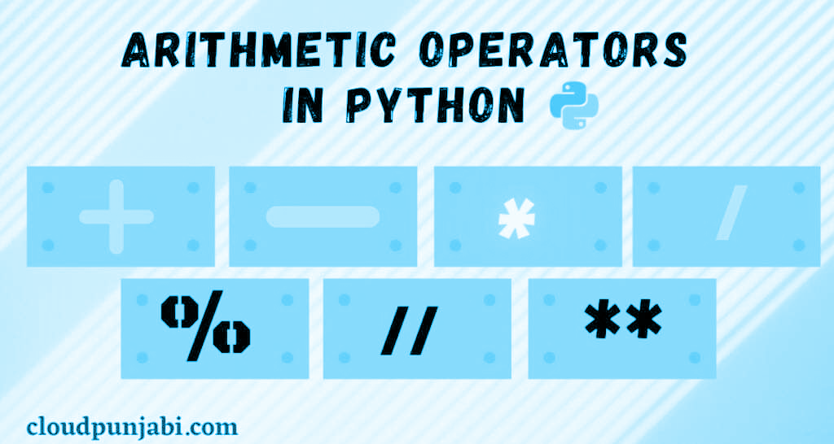
Empower Your Skills, Boost Your Productivity for a Prosperous Pakistan
Operators

Slide 13
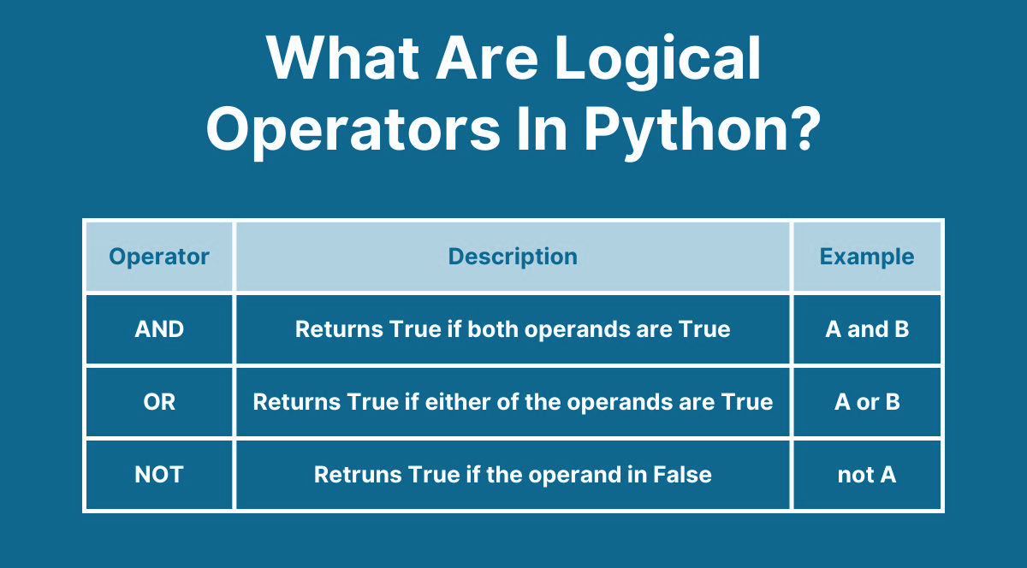
Empower Your Skills, Boost Your Productivity for a Prosperous Pakistan

Slide 14
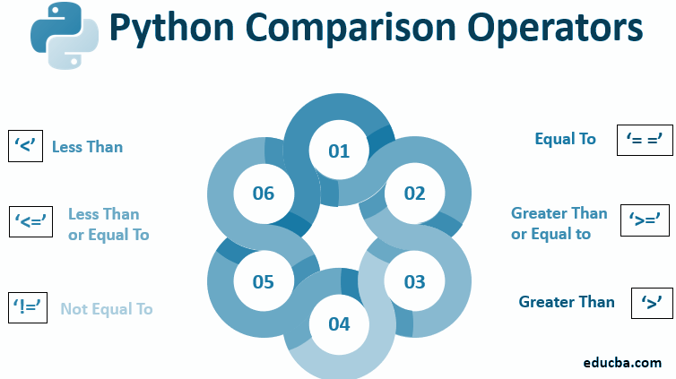
Empower Your Skills, Boost Your Productivity for a Prosperous Pakistan
<
True

Slide 15
Empower Your Skills, Boost Your Productivity for a Prosperous Pakistan
Conditional Statement (If - Elif - Else)
If-Statements take a condition and only runs a block of code if the condition evaluates to True.
Elif-Statements take a condition and only tests it if the prior If-Statement (and all prior Elif-Statements) evaluate to False. It is optional.
Else-Statements take no condition and runs a block of code if the prior If-Statement (and Elif-Statements, if there are any) evaluate to False.
Still confused? Don’t worry! We’ll practice on these next slides! :)

Slide 16


Empower Your Skills, Boost Your Productivity for a Prosperous Pakistan
Lets Run through an Example
Suppose x = -8
elif x == 0
else
if x > 0

Slide 17

Empower Your Skills, Boost Your Productivity for a Prosperous Pakistan
Lets Run through an Example
Suppose x = -8
elif x == 0
else
if x > 0

Slide 18
Empower Your Skills, Boost Your Productivity for a Prosperous Pakistan
Lets Run through an Example
Suppose x = -8
elif x == 0
else
if x > 0

Slide 19

Empower Your Skills, Boost Your Productivity for a Prosperous Pakistan
Lets Run through an Example
Suppose x = -8
elif x == 0
else
if x > 0

Slide 20


Empower Your Skills, Boost Your Productivity for a Prosperous Pakistan
Loop Structures
Used for Repetition of Task

Slide 21
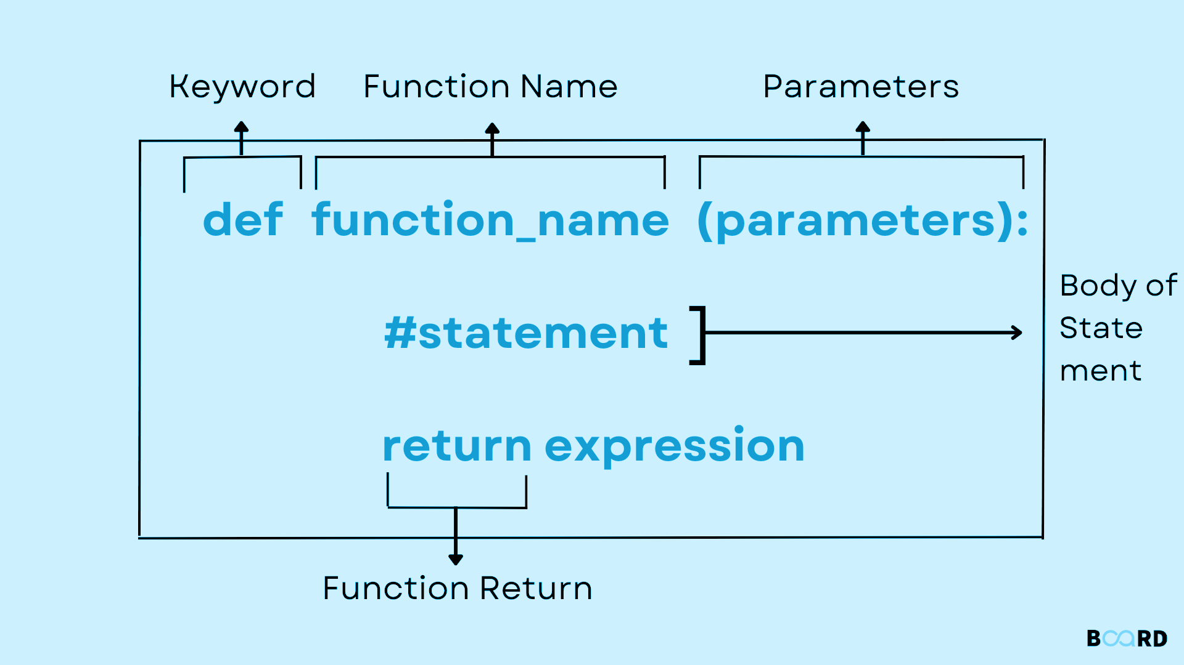
Empower Your Skills, Boost Your Productivity for a Prosperous Pakistan
Functions
Built-in Methods like max(), min(), math.sqrt()
User Defined Methods

Slide 22

Empower Your Skills, Boost Your Productivity for a Prosperous Pakistan
List [ ]
It is used to store multiple Items in a single variable
Neg Index -3 -2 -1

Slide 23

Empower Your Skills, Boost Your Productivity for a Prosperous Pakistan
Tuple ( )
A tuple is a collection similar to List.
The primary difference is that we cannot modify a tuple once it is created.
Neg Index -3 -2 -1

Slide 24
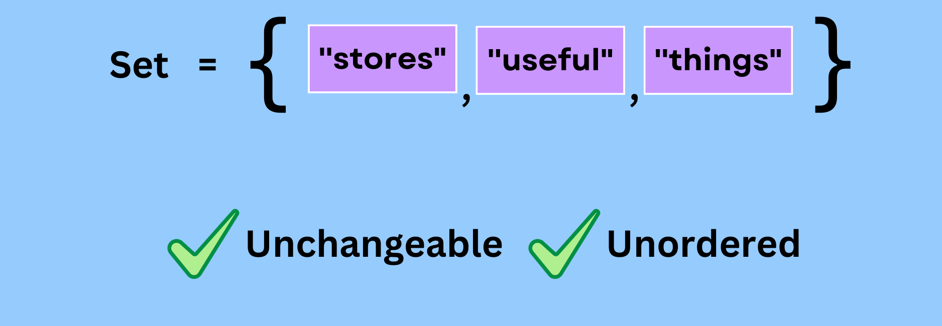
Empower Your Skills, Boost Your Productivity for a Prosperous Pakistan
Set { }
A set is a collection of unique data, meaning that elements within a set cannot be duplicated.
Cannot Use Indexes to fetch items.

Slide 25
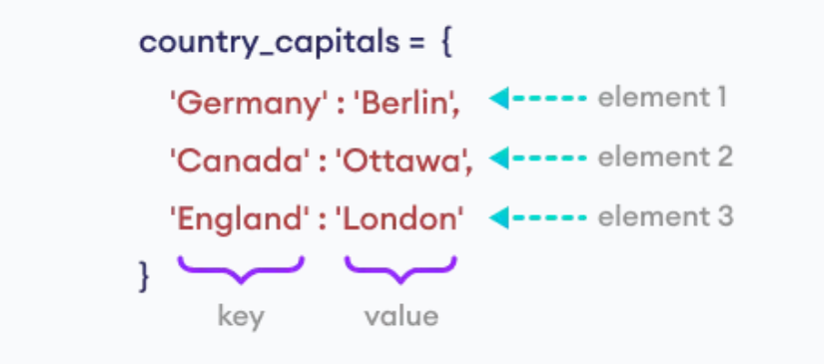
Empower Your Skills, Boost Your Productivity for a Prosperous Pakistan
Dictionary { }
A Dictionary is a key-value pair (consisting of a key and a value)
Keys are always unique.

Slide 26

Empower Your Skills, Boost Your Productivity for a Prosperous Pakistan
Let’s Create a Simple Calculator

Slide 27
Empower Your Skills, Boost Your Productivity for a Prosperous Pakistan
Let’s Create a Simple Calculator

Slide 28
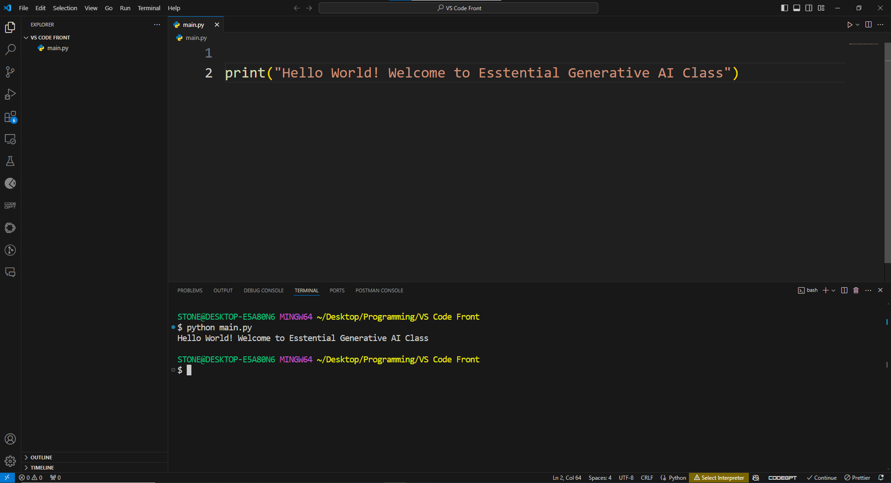
Empower Your Skills, Boost Your Productivity for a Prosperous Pakistan

Slide 29
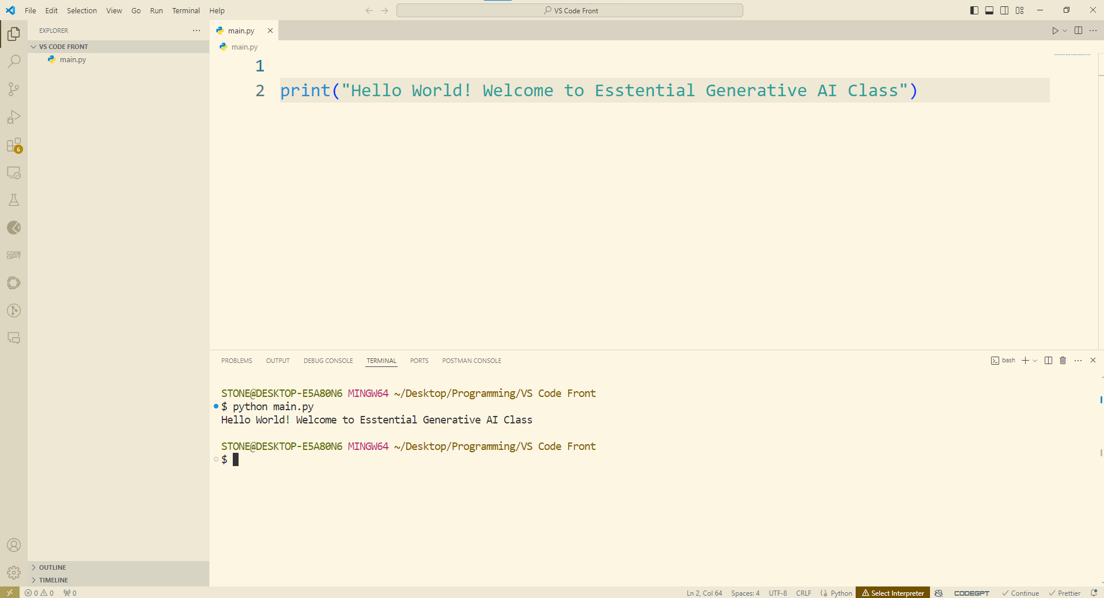

Empower Your Skills, Boost Your Productivity for a Prosperous Pakistan
2
Coding
Area
1
3
Output
Area
Folders &
Files

Slide 30
Empower Your Skills, Boost Your Productivity for a Prosperous Pakistan
Folders and File Area:.
Purpose: This is where you can see and navigate your files and folders. It's essentially your project's directory structure, allowing you to open and manage files.
2
Coding
Area
Coding Area:
Purpose: This is where you write and edit your code.
You can open multiple files in tabs and view your code in a clean, focused environment.
1
3
Output
Area
Folders &
Files
Output Area:
Purpose: This area shows additional information and tools like the Terminal (for running command-line commands), Output (for displaying output from tasks and extensions), Debug Console (for debugging output), and Problems (for listing issues in your code). It provides feedback and interaction for various tasks.

Slide 31
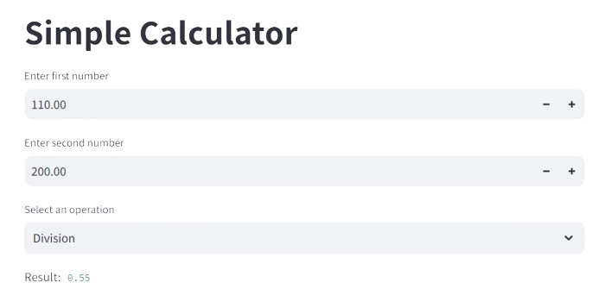
Empower Your Skills, Boost Your Productivity for a Prosperous Pakistan
Create a Simple Calculator using Python and
Streamlit for the Graphical Interface
https://chatgpt.com/share/30ecde20-24a2-4908-b8b1-f6519cbad360

Slide 32


Create a Simple Calculator
Streamlit (cal-pro.streamlit.app)

Slide 33
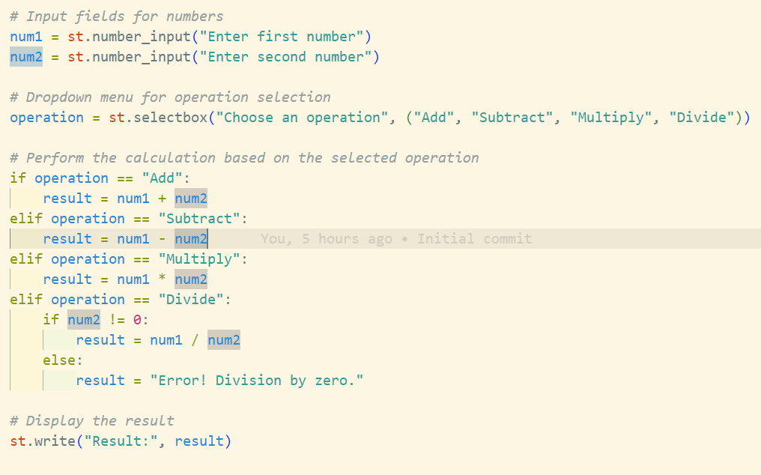
Creating Calculator with Python using Streamlit for UI (youtube.com)

Slide 34


Slide 35
Empower Your Skills, Boost Your Productivity for a Prosperous Pakistan
Practical Demo
GitHub

Slide 36
Empower Your Skills, Boost Your Productivity for a Prosperous Pakistan
Development Environment Setup
What is GitHub?
GitHub is a platform for hosting and sharing code using Git, a version control system.
What is Version Control?
Version control helps manage changes to your codebase, allowing multiple people to work on a project simultaneously and track changes over time.
https://code.visualstudio.com/download
https://github.com/
https://git-scm.com/downloads

Slide 37
Empower Your Skills, Boost Your Productivity for a Prosperous Pakistan
Importance of Version Control
Collaboration:
Multiple developers can work on the same project without conflicts.
History and Tracking:
Track every change made to the codebase and revert to previous versions if needed.
Backup and Recovery:
Keeps a backup of your project on a remote server, preventing data loss.
Branching and Merging:
Experiment with new features or fix bugs in isolated branches before merging them into the main codebase.

Slide 38
Empower Your Skills, Boost Your Productivity for a Prosperous Pakistan
Step 1: Sign in to GitHub
Step 2: Create a New Repository
Once logged in, click on the "+" icon at the top right of the page and select "New repository" from the dropdown menu.
Alternatively, you can go to your profile page and click on the "Repositories" tab, then click the green "New" button.

Slide 39
Empower Your Skills, Boost Your Productivity for a Prosperous Pakistan
Step 3: Configure Your New Repository
Repository Name: Enter a name for your repository. This name should be unique within your GitHub account.
Description (optional):
Public/Private:
Initialize this repository with a README: This file usually contains information about your project.
Add .gitignore (optional): Select a .gitignore template that matches the type of project you’re creating. This file tells Git which files (or patterns) it should ignore.
Choose a license (optional): If you want to, you can select a license for your project. This defines how others can use your project.

Slide 40
Empower Your Skills, Boost Your Productivity for a Prosperous Pakistan
Step 4: Create Repository
click the green "Create repository" button.

Slide 41
Empower Your Skills, Boost Your Productivity for a Prosperous Pakistan
Step 5: Push Code to the Repository (using Git)
Clone the Repository: Open a terminal (or Git Bash on Windows) and run the following commands:

Slide 42
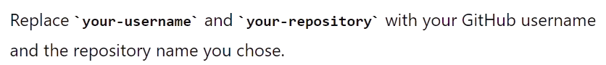
Empower Your Skills, Boost Your Productivity for a Prosperous Pakistan
# Clone the repository to your local machine
git clone https://github.com/your-username/your-repository.git
# Change directory to your repository
cd your-repository
# Add your files to the repository
git add .
# Commit the changes
git commit -m "Initial commit"
# Push the changes to GitHub
git push origin main

Slide 43
Empower Your Skills, Boost Your Productivity for a Prosperous Pakistan
And that's it!
You've successfully created a GitHub repository and
pushed your first code to it.

Slide 44

Empower Your Skills, Boost Your Productivity for a Prosperous Pakistan
LeetCode

Slide 45
Empower Your Skills, Boost Your Productivity for a Prosperous Pakistan
Benefits of Using LeetCode
Title: Benefits of LeetCode for Career Development
Skill Enhancement
Strengthens problem-solving skills
Deepens understanding of algorithms and data structures
Interview Preparation
Real-world interview questions from top tech companies

Slide 46
Empower Your Skills, Boost Your Productivity for a Prosperous Pakistan
Let’s take a little Taste of
Problem Solving
Contains Duplicate
Palindrome Number
https://leetcode.com/

Slide 47
Empower Your Skills, Boost Your Productivity for a Prosperous Pakistan
Let’s take a little Taste of
Problem Solving
LeetCode
Contains Duplicate
https://leetcode.com/

Slide 48
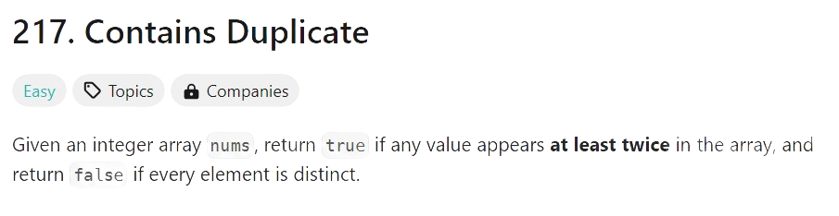
Empower Your Skills, Boost Your Productivity for a Prosperous Pakistan
Contains Duplicate
LeetCode
nums = [1, 2, 3, 1]

Slide 49
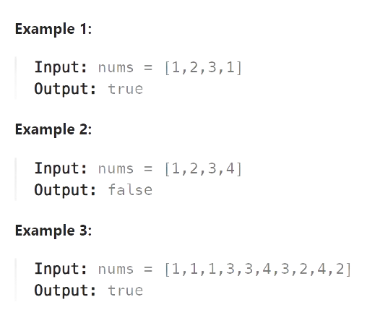
Empower Your Skills, Boost Your Productivity for a Prosperous Pakistan
LeetCode

Slide 50
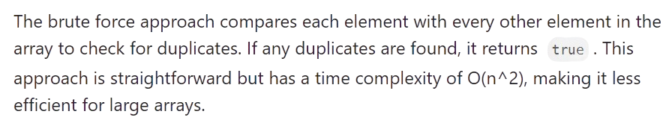
Empower Your Skills, Boost Your Productivity for a Prosperous Pakistan
Contains Duplicate
Approach 1: Brute Force
LeetCode
nums = [1, 2, 3, 1]

Slide 51
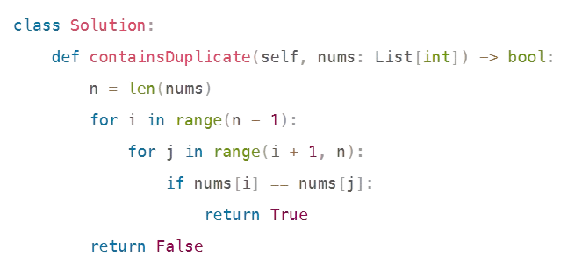
Empower Your Skills, Boost Your Productivity for a Prosperous Pakistan
Contains Duplicate
Approach 1: Brute Force
LeetCode
nums = [1, 2, 3, 1]

Slide 52
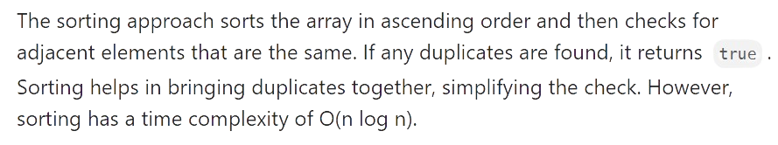
Empower Your Skills, Boost Your Productivity for a Prosperous Pakistan
Contains Duplicate
Approach 2: Sorting
LeetCode
nums = [1, 2, 3, 1]

Slide 53
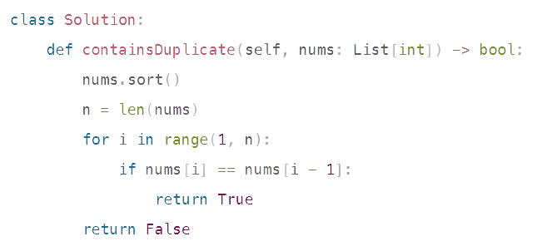
Empower Your Skills, Boost Your Productivity for a Prosperous Pakistan
Contains Duplicate
Approach 2: Sorting
LeetCode
nums = [1, 2, 3, 1]

Slide 54
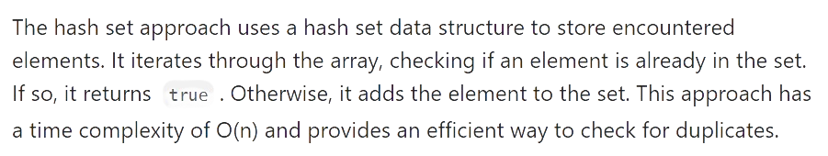
Empower Your Skills, Boost Your Productivity for a Prosperous Pakistan
Contains Duplicate
Approach 3: Hash Set
LeetCode
nums = [1, 2, 3, 1]

Slide 55
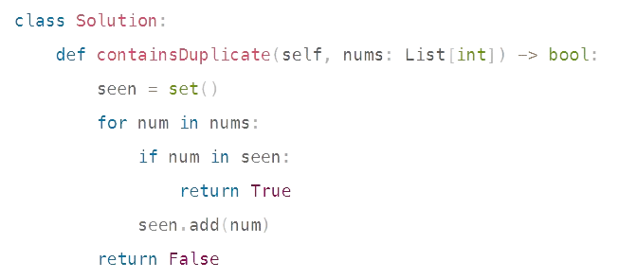
Empower Your Skills, Boost Your Productivity for a Prosperous Pakistan
Contains Duplicate
Approach 3: Hash Set
LeetCode
nums = [1, 2, 3, 1]

Slide 56
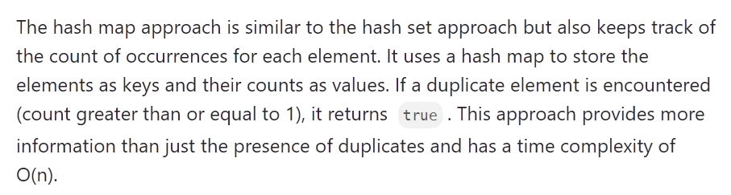
Empower Your Skills, Boost Your Productivity for a Prosperous Pakistan
Contains Duplicate
Approach 4: Hash Map
LeetCode
nums = [1, 2, 3, 1]

Slide 57
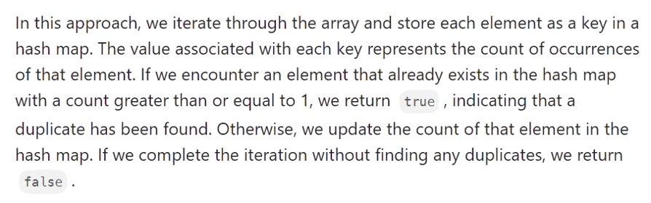
Empower Your Skills, Boost Your Productivity for a Prosperous Pakistan
Contains Duplicate
Approach 4: Hash Map
LeetCode
nums = [1, 2, 3, 1]

Slide 58
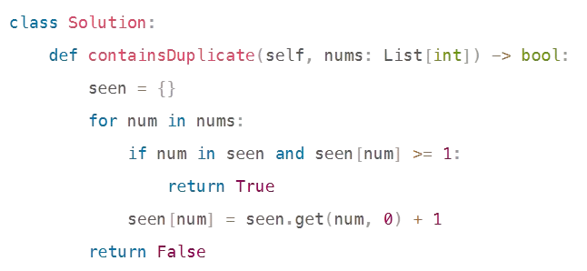

Empower Your Skills, Boost Your Productivity for a Prosperous Pakistan
Contains Duplicate
Approach 4: Hash Map
LeetCode
nums = [1, 2, 3, 1]

Slide 59
Empower Your Skills, Boost Your Productivity for a Prosperous Pakistan
Regards,
Zulfiqar Ali Mir &
Muhammad Talha
LinkedIn: https://www.linkedin.com/in/zulfiqar-ali-mir/ https://www.linkedin.com/in/muhammmad-talha/

Slide 60

Empower Your Skills, Boost Your Productivity for a Prosperous Pakistan
Regards,
Zulfiqar Ali Mir &
Muhammad Talha
LinkedIn: https://www.linkedin.com/in/zulfiqar-ali-mir/ https://www.linkedin.com/in/muhammmad-talha/

